Slide 1

MMS Science Operations, Science Data System, and Data Access
MMS Contact: Kris Larsen, lead for the MMS Science Data Center
Kristopher.Larsen@lasp.colorado.edu
Barbara Giles, helps Kris out on occasion barbara.giles@nasa.gov

Slide 2
Planning for GEM Tutorial
SOFTWARE:
SPEDAS scripts for creating full range of QL plot types (with capability to plot L2 quality rather than QL)
Specialty scripts to for individual distributions, visualization of spacecraft formation, and to perform data quality checks (e.g., E=vxB)
inclusion of MMS within the SPEDAS GUI
INFORMATION:
demonstration of data query functions
representation from each instrument team to inform on data products and their quality and caveats
browse of the MMS SDC site, how to access documentation including instrument data user’s guides

Slide 3
MMS DATA MANAGEMENT
The SDC will make available Quicklook, Level-2, and Level-3 science data to the science community and general public.
Beginning as soon as possible but no later than 6-months after instrument commissioning, begin routinely generating Level-2 science data products and deliver to the SOC within 30 days of downlink from each spacecraft.
Provide data access and visualization tools to the SDC. These tools will support SDC provided interfaces and will also be made available to the science community.
MMS Data Management follows NASA Policy and was approved in 2011. References:
NASA Heliophysics Science Data Management Policy, version 1.1, April 12, 2009
NASA MMS Science Data Management Plan: SwRI Document 10160.18-PDMP-01
Public Access to MMS L2 Data begins no later than March 1, 2016

Slide 4
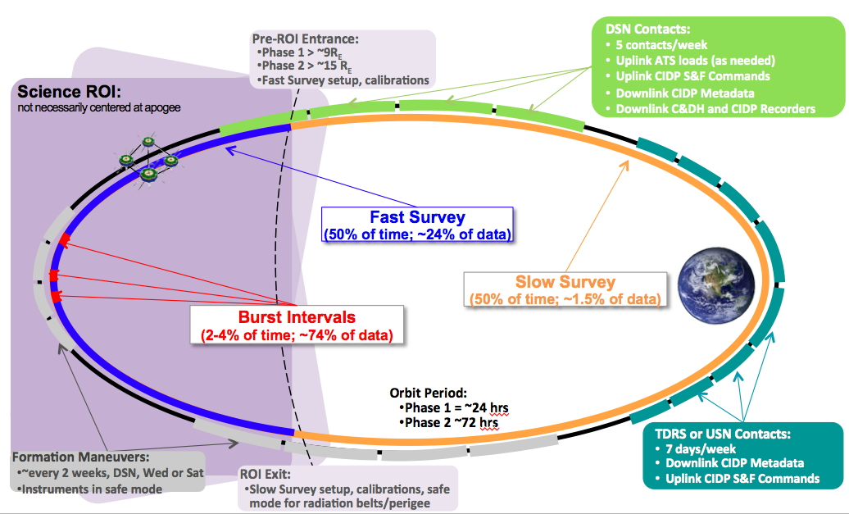
MMS Science Operations

Slide 5
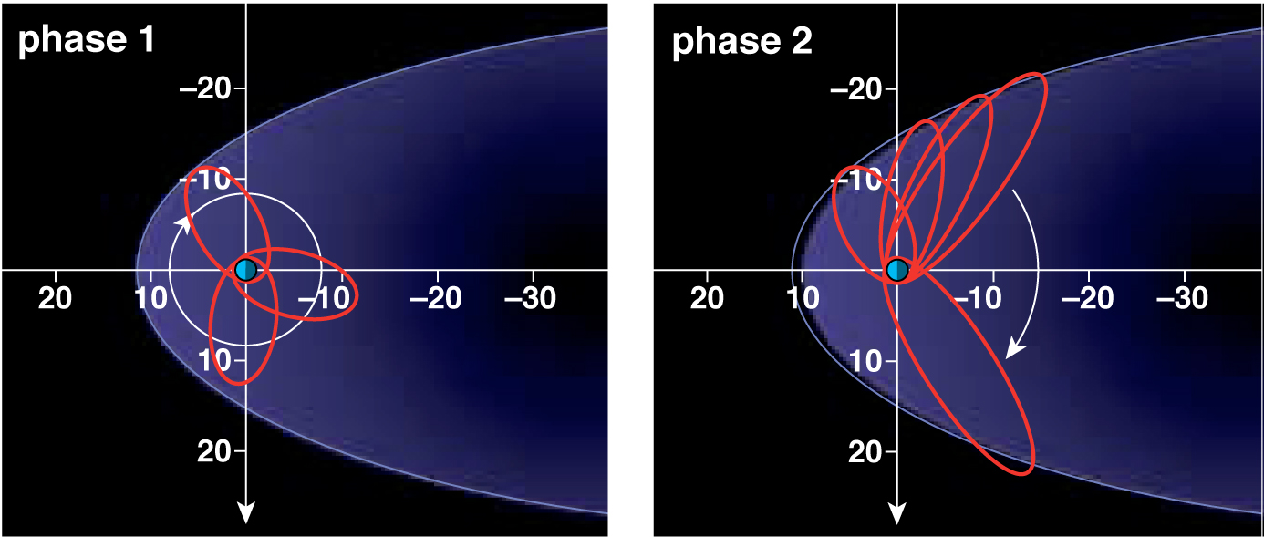
Orbital Phases
  Two mission phases with inclination 28 deg. to optimize encounters with both dayside and nightside reconnection regions.

Slide 6
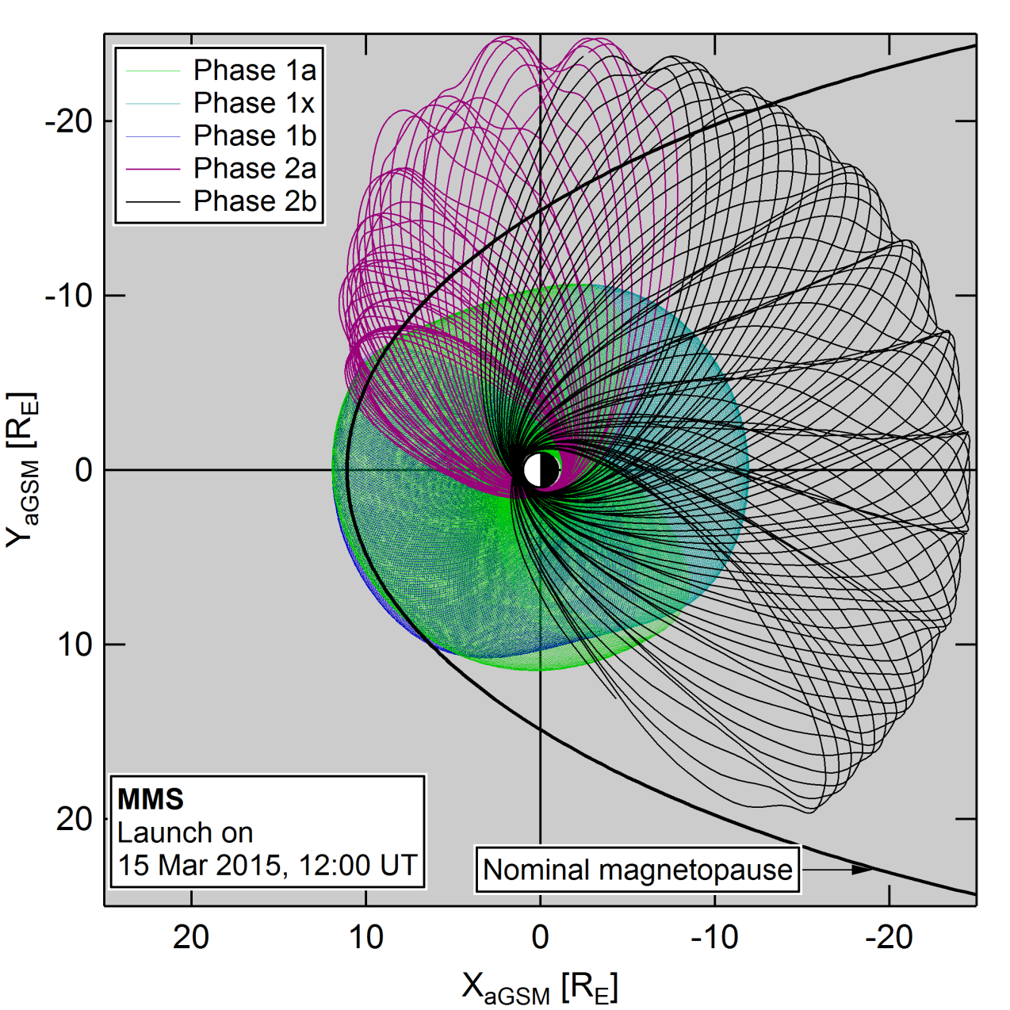
Phases of the two-year prime mission
Phase 1a – Sept 1, 2015
Phase 1x – Mar 8, 2016
Phase 1b – Sept 26, 2016
Phase 2a – Jan 31, 2017
Phase 2b – May 1, 2017
Launch 12 March 2015 at 10:44pm
Credits: Stephen Fuselier, Steve Petrinec, Karlheinz Trattner, Conrad Schiff, NASA FDOA

Slide 7
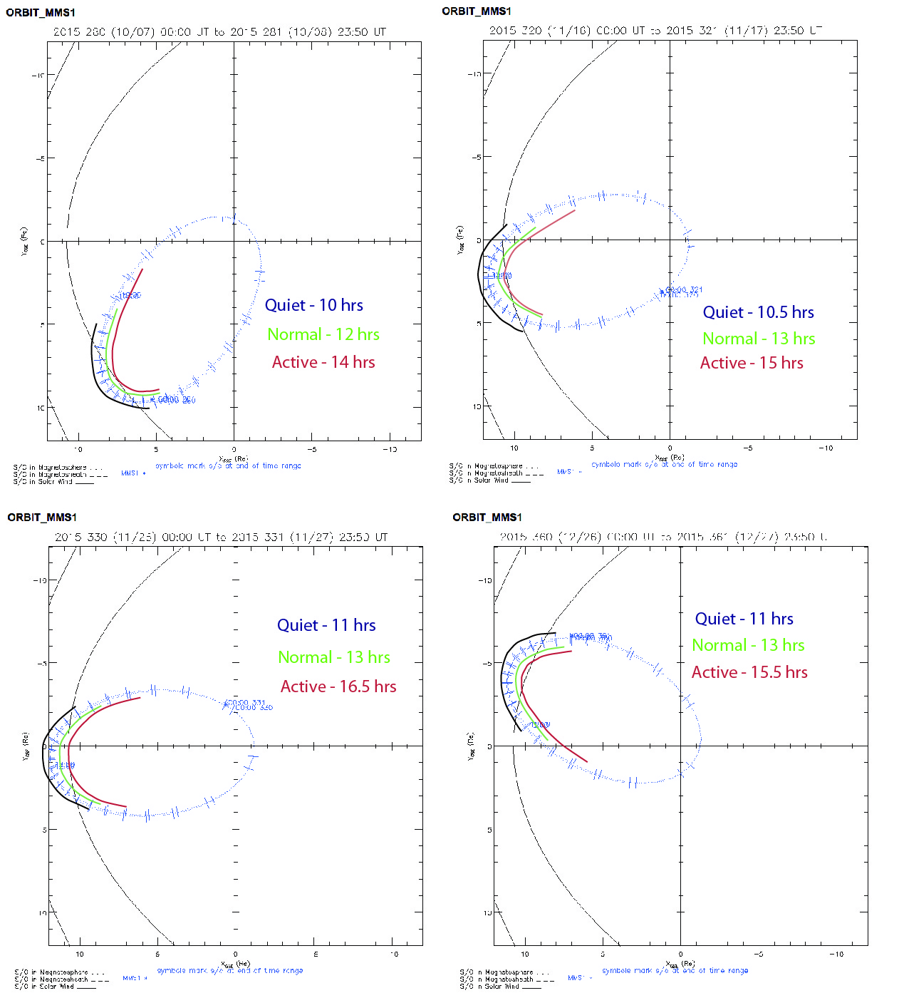
Modifying the Science ROI
Examined 3 types of science regions of interest (ROI)
  Quiet, Normal, Active
Optimize start and stop based on MLT and solar wind conditions from previous solar rotations
Credit: Steve Petrinec, Stephen Fuselier
Notes:
ADVANTAGES:
Based on predictions: Keep the spacecraft in fast survey/burst acquisition when the magnetopause is compressed
Total time in fast survey over phase 1a, 1b may be the same as if the Science ROI was “normal”
No additional data volume over the mission phase
CHALLENGES:
Much more complicated mission operations
Data acquisition changes from orbit to orbit
Several orbits of “active” produces too much data to store
Cannot keep a burst data backlog of 3 orbits of MP crossings – may miss some crossings
Can’t predict the solar wind density 2 weeks in advance
Let’s try with the velocity!

Slide 8
Observatory Formation
Initialization at 160 km was DOY 188/190 (July 7/9)
Maintenance at 160 km was DOY 211 (July 30)
Maintenance at 160 km (start of Phase 1A) was DOY 243/244 (Aug 31/Sept 1)
Resize to 60 km was DOY 259/260 (Sept 16/17)
Resize to 25 km was DOY 273/274 (Sept 30/Oct 1)
Resize to 10 km was DOY 287/288 (Oct 14/15)
Resize to 40 km will be DOY 350/351 (Dec 16/17)

Slide 9
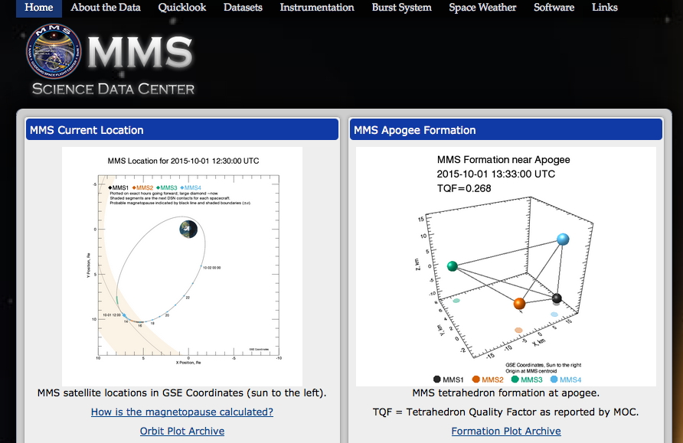
One site: Access to all MMS Data
https://lasp.colorado.edu/mms/sdc/
Credits to LASP: Kris Larsen, Kim Kokkonen

Slide 10
browse access and query services
https://lasp.colorado.edu/mms/sdc/

Slide 11
quicklook plots and SPEDAS scripts to produce same
https://lasp.colorado.edu/mms/sdc/

Slide 12
Demonstrations
https://lasp.colorado.edu/mms/sdc/

