Slide 1
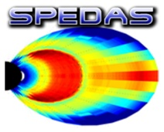

SPEDAS Developers Workshop
GEM – San Francisco, CA
December 2015

Slide 2
Agenda
SPEDAS Developers Workshop
3:30-3:45 Opening remarks Vassilis Angelopoulos,
Jim Lewis
3:45-4:00 SPEDAS development status
and roadmap Jim Lewis
4:00-4:15 MMS Plugin Preview Barbara Giles
4:15-4:30 BARREL (and other?) plugin status Robyn Millan, others?
4:30-5:00 Q&A, discussion, planning for summer All
GEM
5:00-5:30 SPEDAS tech support clinic Jim Lewis, others?

Slide 3
What is SPEDAS?
Space Physics Environment Data Analysis Software
(SPEDAS)
  Grass-roots data analysis software for Space Physics Community
  SPEDAS is an outgrowth of THEMIS / ARTEMIS that supports multiple missions
  Standardizes retrieval of data from distributed repositories
  Science processing and graphics contain powerful set of legacy routines.
  The THEMIS mission is served through the TDAS plugin
The SPEDAS framework:
  Contains a GUI for ease of use (available through IDL VM freeware)
  Command line provides full access to IDL (paid license only)
  - Works with Windows, Linux and Mac OS X.
  - Is based on IDL, benefiting from platform independence and software maintenance services.

Slide 4
What’s new!
SPEDAS: Version 1.00 released in August 2014
  Support for loading netCDF files into tplot!
SPEDAS GUI:
  - Support for loading/analyzing/plotting CDAWeb data
  - API plugins for GOES, ACE, WIND, POES, FAST, BARREL,
  ERG & IUGONET, OMNI, and Geomagnetic/Solar Indices
  Tsyganenko field model support (IDL Geopack) for magnetic
  field modeling
  - All GOES magnetic field and particle data available

Slide 5
What is the current status of SPEDAS development?
  SPEDAS 1.00 was released in August 2014, including plugins supporting THEMIS, GOES, and IUGONET, as well as a general purpose interface for loading many other missions via CDAWeb.
  Other new features available via the SPEDAS 1.00 GUI include tools for loading various geomagnetic indices, and an interface to the GEOPACK magnetic field modelling library.
  The SPEDAS 1.00 plugin API gives plugin developers access to the “Load Data” and “Configuration Settings” panels, and the ability to add items to the “Plugins” top level menu.
  In addition to the IDL source code (which requires a full IDL license to use), the deliverables for SPEDAS 1.00 included precompiled executables for the most popular platforms (Windows, Linux, and MacOs), allowing users without IDL licenses to use all the features available within the SPEDAS GUI (but not the complete set of command line tools).

Slide 6
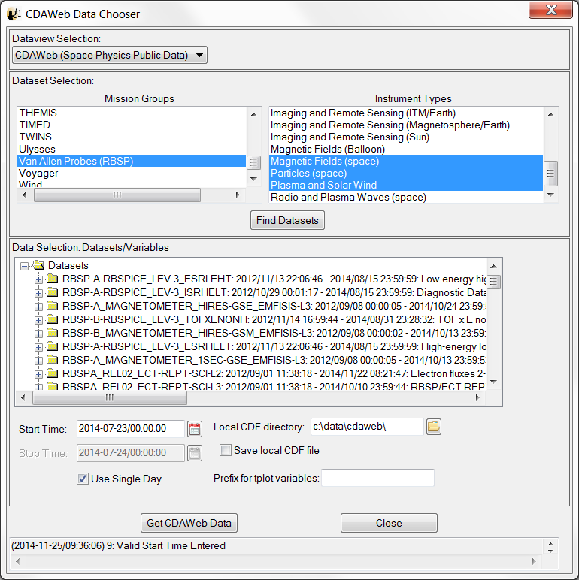
Loading CDAWeb Data
To Load CDAWeb Data:
Select ‘Load Data using CDAWeb’
under the File menu
- Select Mission Group (i.e., TWINS, Cluster, RBSP, etc.)
- Select the Instrument Type
- Click ‘Find Datasets’
Select variable or dataset to download
Click ‘Get CDAWeb Data’

Slide 7
THEMIS and RBSP Plots
With a few clicks of the
button the user can
load, analyze, and plot
data.
Interactive Capabilities

Slide 8
SPEDAS Mini Language
Simple scripting language has been written in IDL.
This language allows access to some data analysis functionality in the IDL
virtual machine and eases manipulations of time series (tplot) data
This language allows composition of statements and functions with order of
operations to give significant flexibility in statement construction
Examples:
1: Position to RE:
calc,'"tha_pos_re" = "tha_state_pos"/6374.4’
2: Natural log of total esa density:
calc,'"tha_density_log"
=ln("tha_peir_density"+"tha_psif_density“)
3: Average magnetic pressure:
calc,'Pb_avg = mean(0.01*total("tha_fgs_dsl"^2,2)/25.132741)‘
Additional examples can be found in general/examples/crib_calc.pro
reduced

Slide 9
Data Analysis
Available Data
Active Data
Common Functions

Slide 10
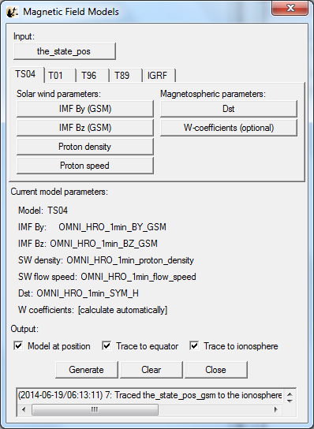
Magnetic Field Models
The GUI is now able to:
Model the field at the spacecraft
position
Trace field from position to
the ionosphere and equator

Slide 11
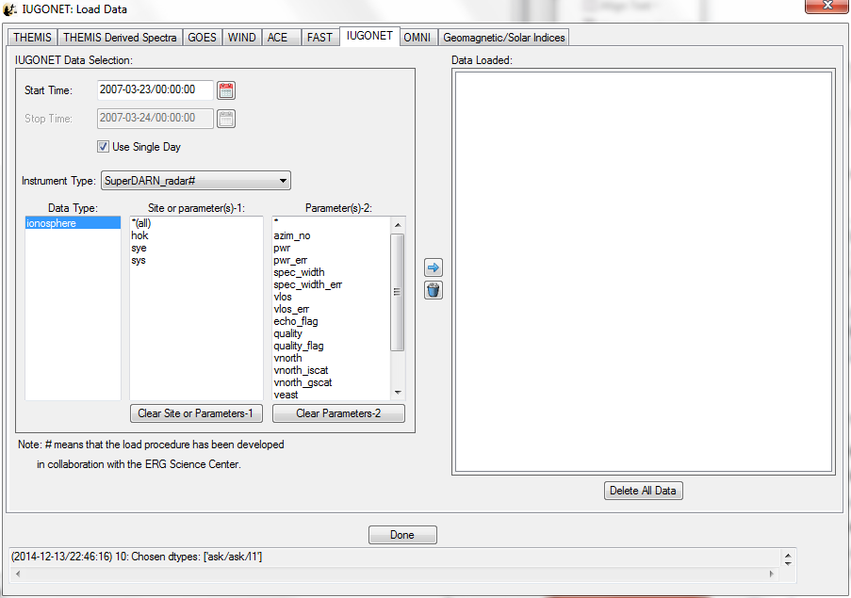
Load Data panel (IUGONET plugin tab)

Slide 12
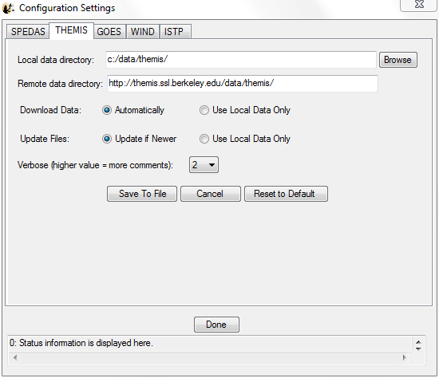
Configuration settings panel (THEMIS plugin tab)

Slide 13
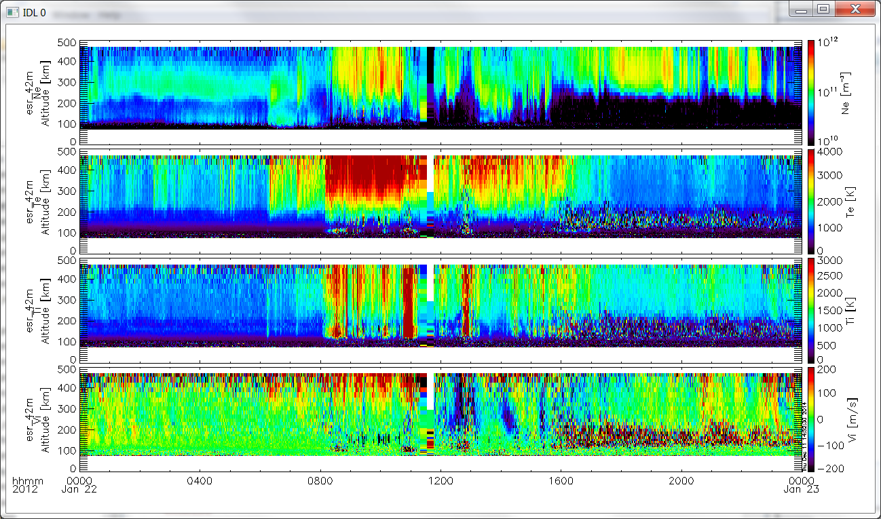
IUGONET, OMNI, Field Data
crib_iugonet_20120122sc.pro
Yoshimasa Tanaka

Slide 14
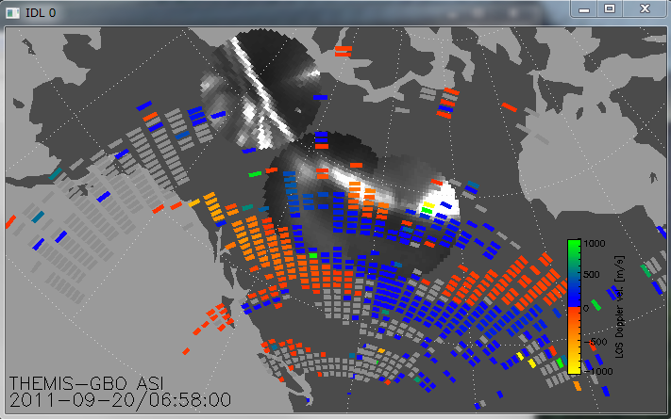
THEMIS ASI / SuperDarn Radar
erg-sc_crib_thmasi_sd_sample
Tomo Hori

Slide 15
SPEDAS Development Roadmap
  Current “Bleeding Edge” nightly builds now include MMS plugin and tools.
  A MAVEN plugin is under development. We also hope to support the MMS and Van Allen missions with SPEDAS plugins.
  The interface between plugins and the SPEDAS GUI is being simplified. Currently each feature (e.g. the “Load Data” panel, the “Configuration Settings” panel, the “Plugins” menu) requires a separate configuration file, with information about all plugins that use that feature. So adding a new plugin may require manual edits to several files, which doesn’t scale well as additional “hooks” are added to SPEDAS. The new system will use a single configuration file per plugin, so that installing a plugin is more of a “drag and drop” operation.
  The “Data Analysis” panel is still somewhat specific to THEMIS (especially regarding the set of coordinate transforms supported). We are generalizing this panel so that each plugin can use this interface to expose their preferred set of coordinate transforms and other tools.
  Our QA procedures, release schedule, and set of deliverables need a bit more flexibility to keep up with new plugins as they are released or updated.

Slide 16
SPEDAS Development Roadmap
  The “Load Data using CDAWeb” panel uses a number of routines from the CDAWlib library distributed by GSFC. For SPEDAS 1.00, we had to use a heavily modified version of CDAWlib: all routine names and call sites had a unique prefix added to resolve naming conflicts, and a number of calls to the IDL EXECUTE routine were rewritten so that the panel would work in the IDL Virtual Machine environment. For future releases, we hope to pass some of our changes (e.g. removal of EXECUTE calls) upstream to the CDAWLib developers, and to identify the smallest subset of the CDAWlib library required to support the CDAWeb feature, to reduce the number of naming conflicts that need to be resolved.
  Currently, all crash reports and help requests are routed to the THEMIS science support address, even if the crash or problem occurs in some other plugin. Future releases should allow each plugin to define its own error handlers and reporting policy.

Slide 17
Spedas.org is now live!
  SPEDAS and plugin downloads
  Documentation wiki
  Mailing list
  Blog
We welcome plugin developers to contribute content and participate in discussions on the SPEDAS site! (Registration required for wiki and blog edit privileges; please contact Jim Lewis (jwl@ssl.Berkeley.edu) to gain access).

Slide 18
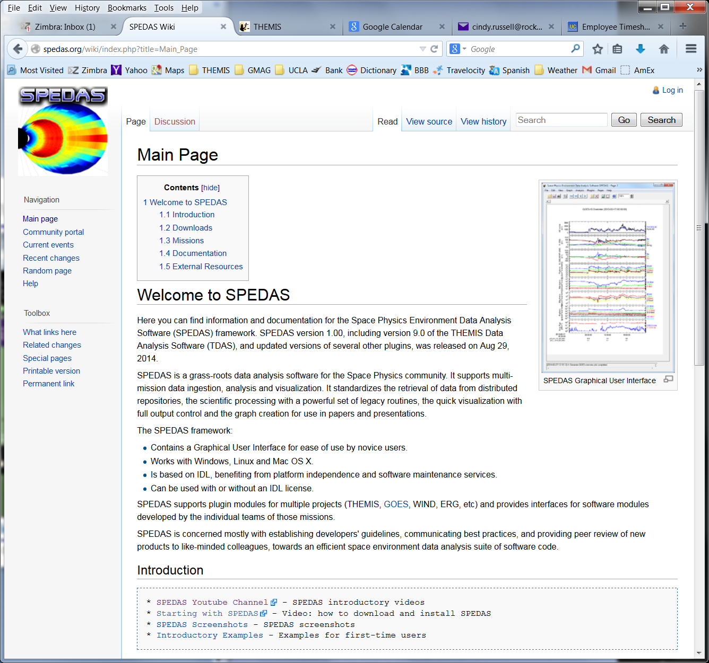
SPEDAS Wiki
Introduction:
- You Tube Channel
SPEDAS video
Introductory Examples
Screen shots
spedas.org/wiki

Slide 19
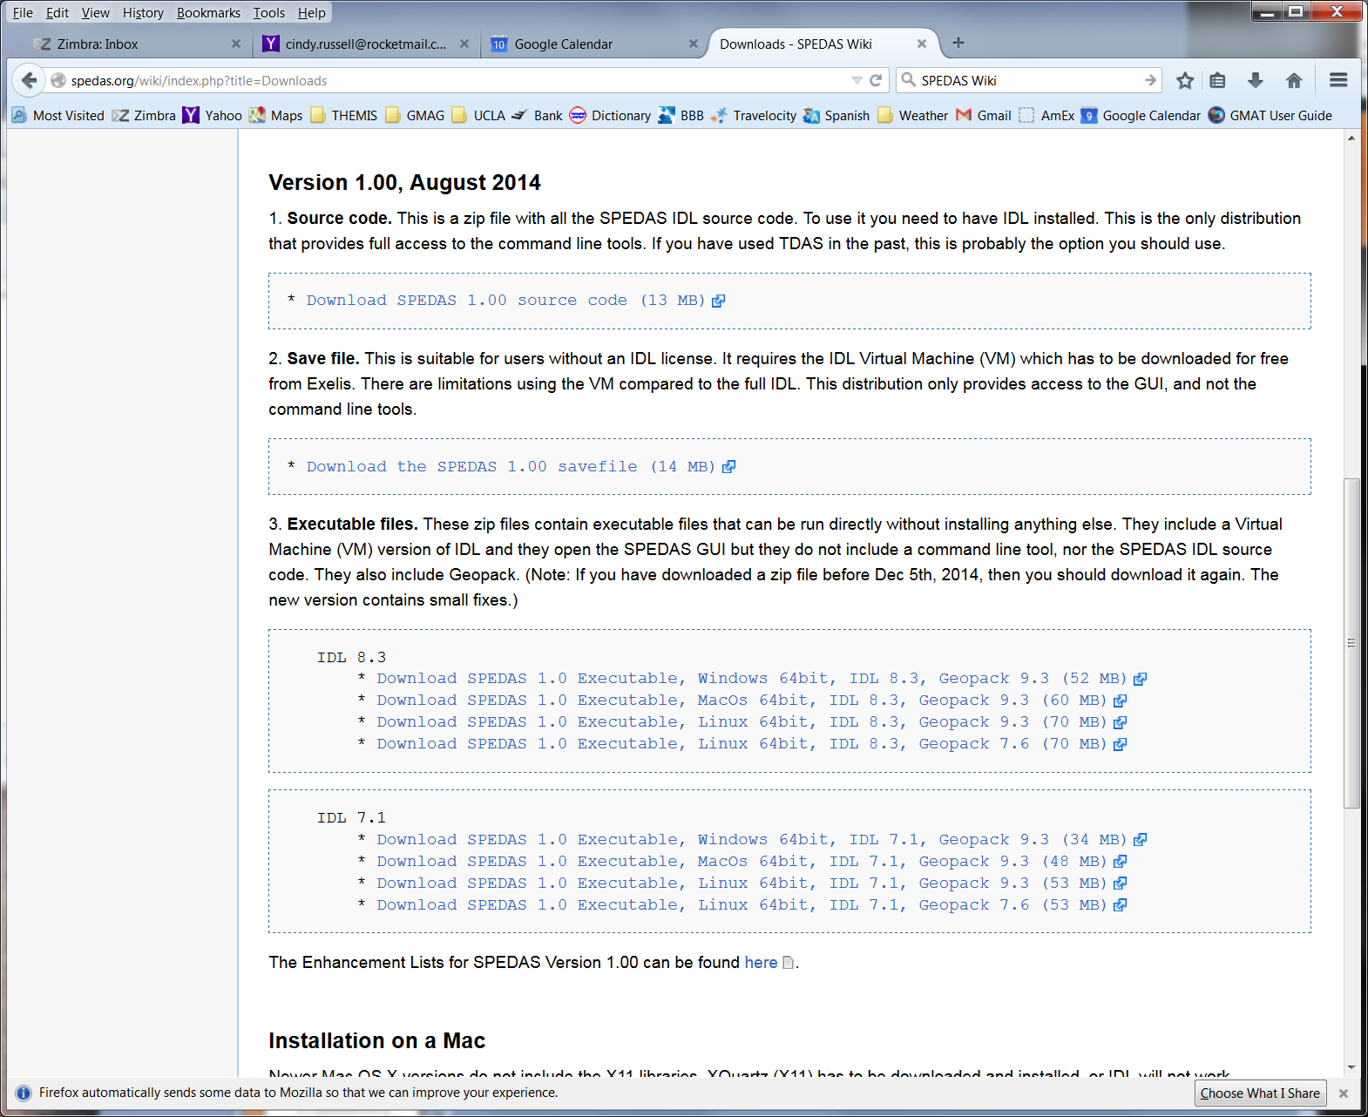
SPEDAS Downloads
Select:
1.2 Downloads
From Main Page
spedas.org/wiki/index.php?title=Downloads

Slide 20
“New Features (nightly “bleeding edge” builds)
For the past year, University of Calgary has been operating a system of Redline all-sky cameras
The THEMIS project has agreed to make the data available to the scientific community in the form of ISTP-compatible CDF files, similar to the THEMIS-GBO all-sky files.
Bleeding edge builds now include procedures to generate the CDF files and have SPEDAS read and process the files.
Files are available for November 2014 so far, and data through Spring 2015 is being processed and published as we speak.
Contact Harald Frey (hfrey@ssl.Berkeley.edu) for more information

Slide 21
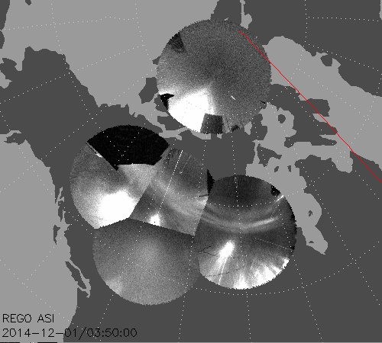
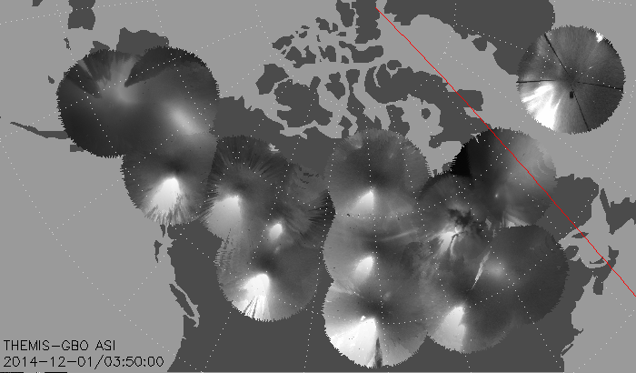
THEMIS/GIMNAST white-light all-sky cameras
UCalgary Redline Emission Geophysical Observatories (REGO)
IDL command:
thm_asi_merge_mosaic,’2014-12-01/03:50:00’
Need to download latest version of SPEDAS with procedures thm_rego_create_mosaic.pro, thm_load_rego.pro, thm_rego_array.pro
Update path to !themis.local_data_dir/thg/l1/reg/
Update file !themis.local_data_dir/thg/l2/asi/cal/thm_map_add.sav
IDL command:
thm_rego_create_mosaic,’2014-12-01/03:50:00’

Slide 22
Loading MMS Data in SPEDAS
Instrument | Load routine
FPI | mms_load_fpi
HPCA | mms_load_hpca
EIS | mms_load_eis
FEEPS | mms_load_feeps
AFG/DFG | mms_load_afg/mms_load_dfg
SCM | mms_load_scm
ASPOC | mms_load_aspoc
EDI | mms_load_edi
EDP | mms_load_edp
DSP | mms_load_dsp

Slide 23
Loading MMS Data in SPEDAS
Keywords:
  trange: time range of interest
    Ex: trange=[‘2015-9-1’, ‘2015-9-2’]
  probes: list of MMS probe #s
    Ex: probes=[1, 2, 3, 4] ; all 4 s/c
  level: Level of the data to load (‘ql’, ‘l2’, ..)
    Ex: level=‘ql’ ; load quicklook data
  data_rate: rate of the data (‘fast’, ‘srvy’, ‘brst’, ‘slow’)
    Ex: data_rate = ‘brst’
  datatype: specify a type of data to load (instrument dependent)
    FPI ex: datatype=‘des’

Slide 24
Loading MMS Data in SPEDAS
To load MMS1, L2 DFG data for 9/1/2015:
  mms_load_dfg, trange=[‘2015-9-1’, ‘2015-9-2’], probe=1, level=‘l2’
Examples for loading/plotting MMS data can be found at:
  projects/mms/examples

